Slide 1

DATA ENGINEERING 1 – SQL FOR ANALYSTS
CHAPTER 1
Laszlo Sallo
SEPTEMBER 2020

Slide 2

WHO ARE YOU?

Slide 3
WHO ARE YOU?
STATISTICIAN
DATA MINER
PREDICTIVE ANALYTICS
BUSINESS
ANALYST
DATA SCIENTIST
ENTERPRISE
DATA ANALYST
BUSINESS
SCIENCE

Slide 4
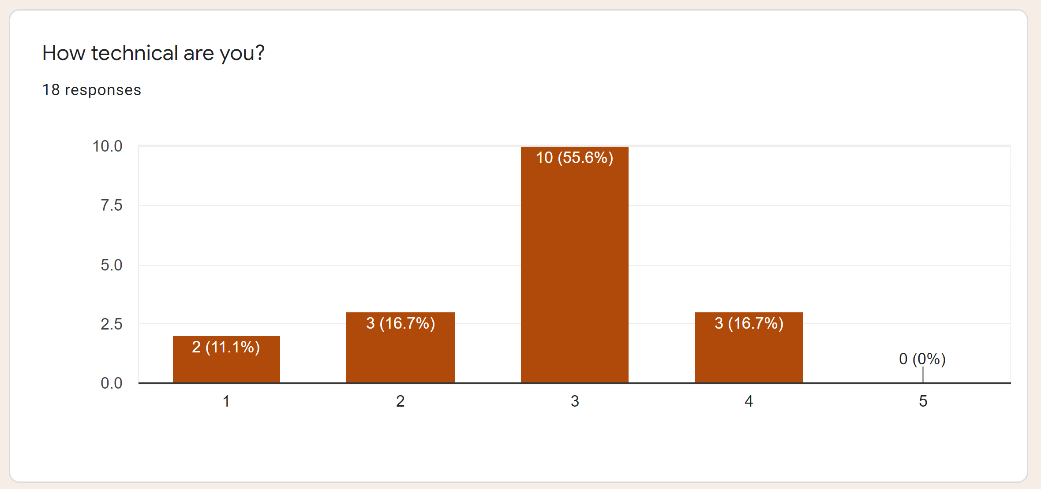
HOW TECHNICAL ARE YOU?

Slide 5
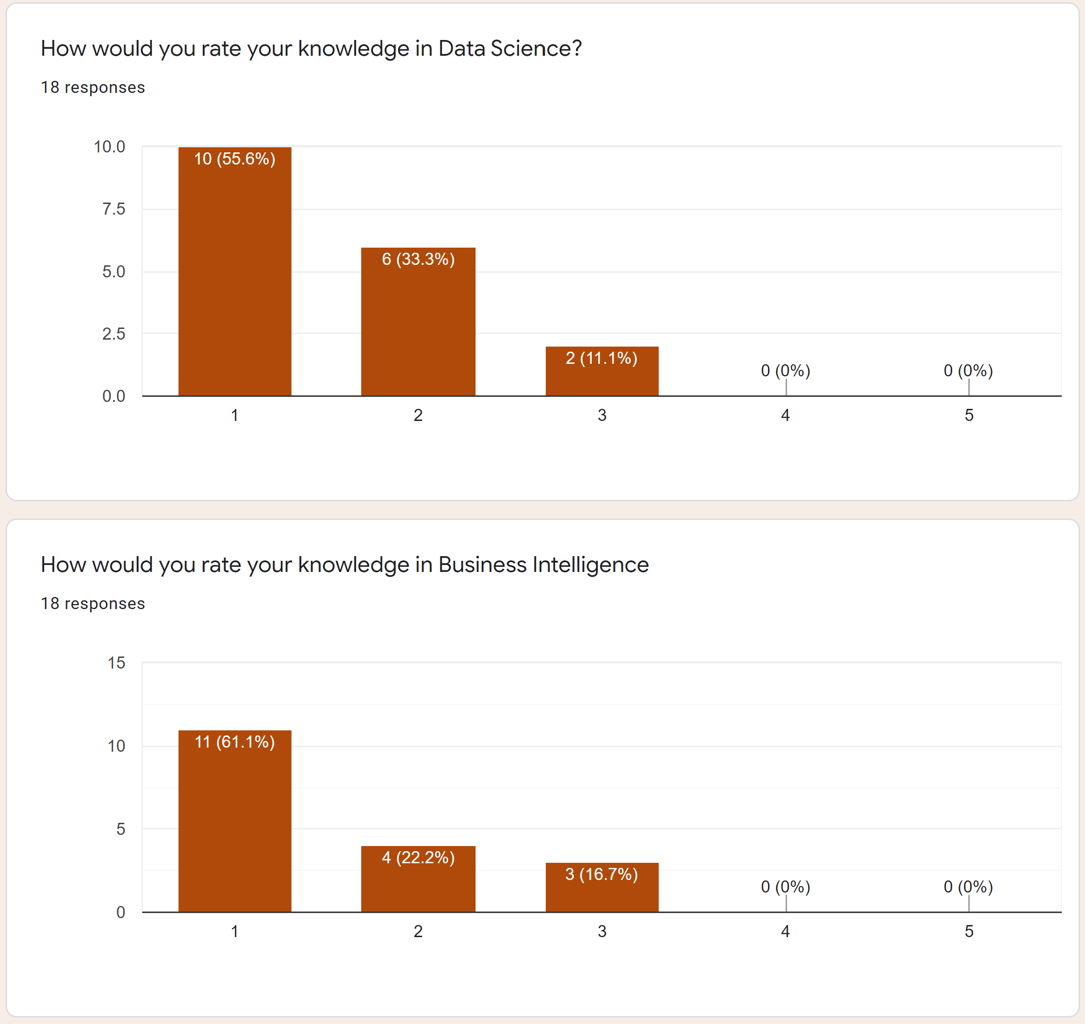
DATA SCIENCE KNOWLEDGE

Slide 6
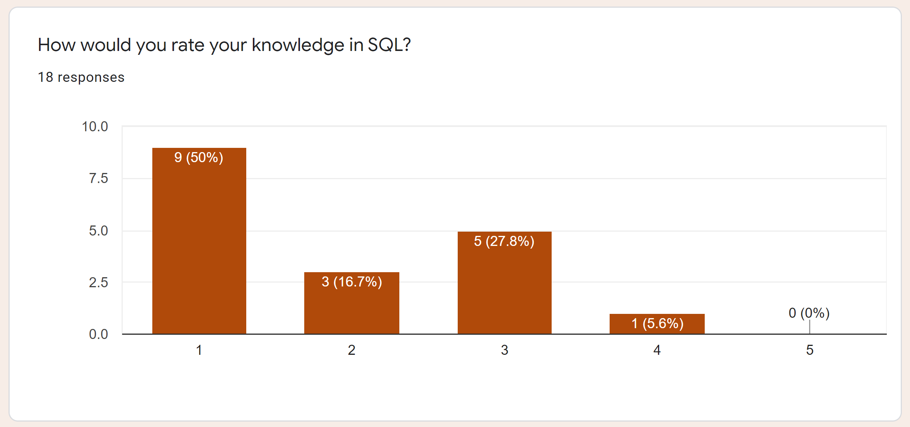
SQL KNOWLEDGE

Slide 7
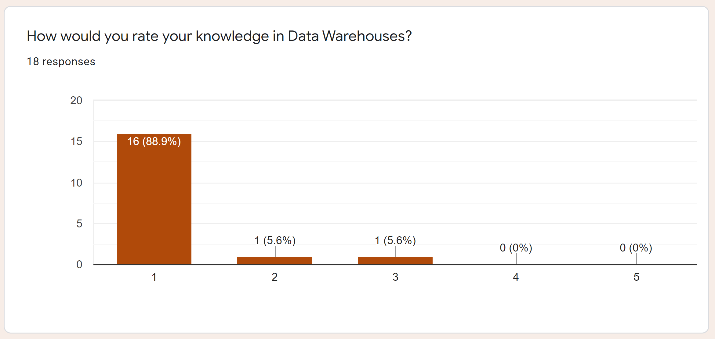
DATA WAREHOUSE KNOWLEDGE

Slide 8
COURSE SUMMARY
MANIPULATING DATABASE
WITH SQL USING MYSQL AS
RELATIONAL DATABASE MANAGEMENT SYSTEM

Slide 9

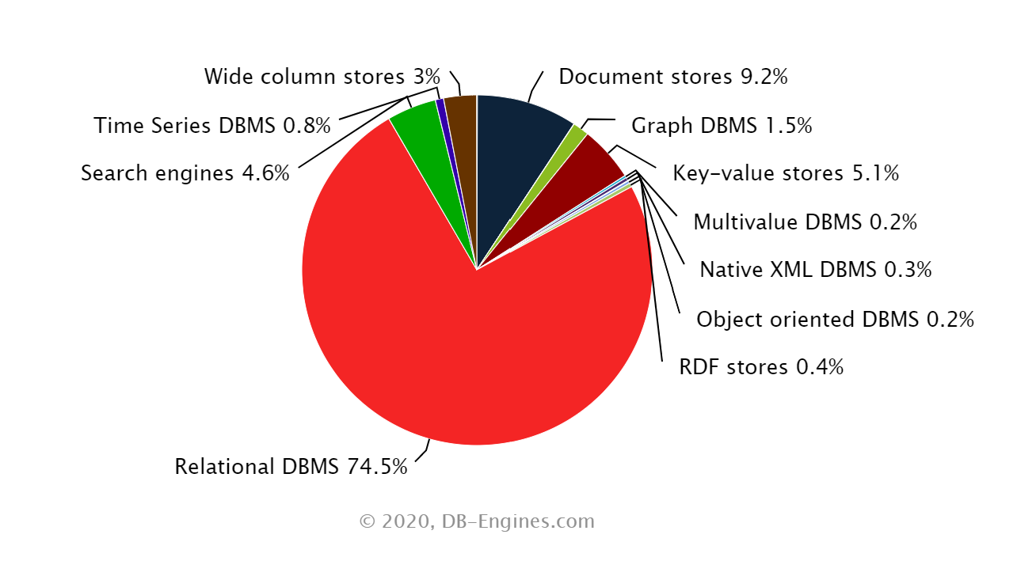
WHY?

Slide 10
SQL IN 5 MINUTES
IN A CHROME BROWSER
GOOGLE
The Try-SQL Editor

Slide 11
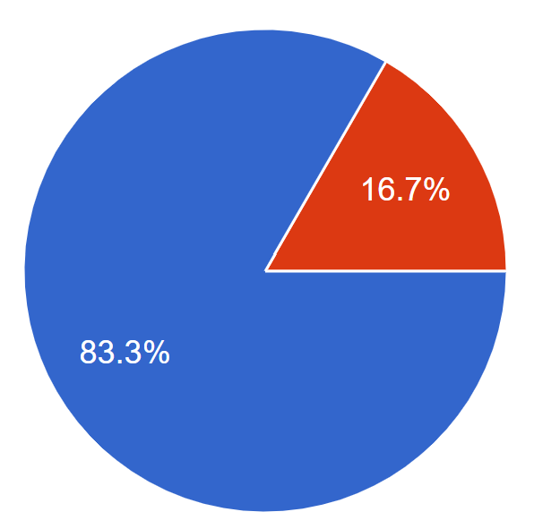
COURSE SCHEDULE
CHAPTER 1. INTRO. LOCAL ENVIRONMENT. BASIC SQL. YOUR FIRST DATABASE. DUMPS.
CHAPTER 2. ALTERING DB. SECURITY. DATA TYPES. LOGICAL OPERATORS. FILTERING.
CHAPTER 3. CONDITIONAL LOGIC. AGGREGATING. GROUPING.
CHAPTER 4. DATA WAREHOUSE ARCHITECTURE. RELATIONAL DATASETS. JOINS.
CHAPTER 5. STORED PROCEDURES
CHAPTER 6. EVENTS. TRIGGERS. VIEWS. ETL. DATA MARTS.

Slide 12
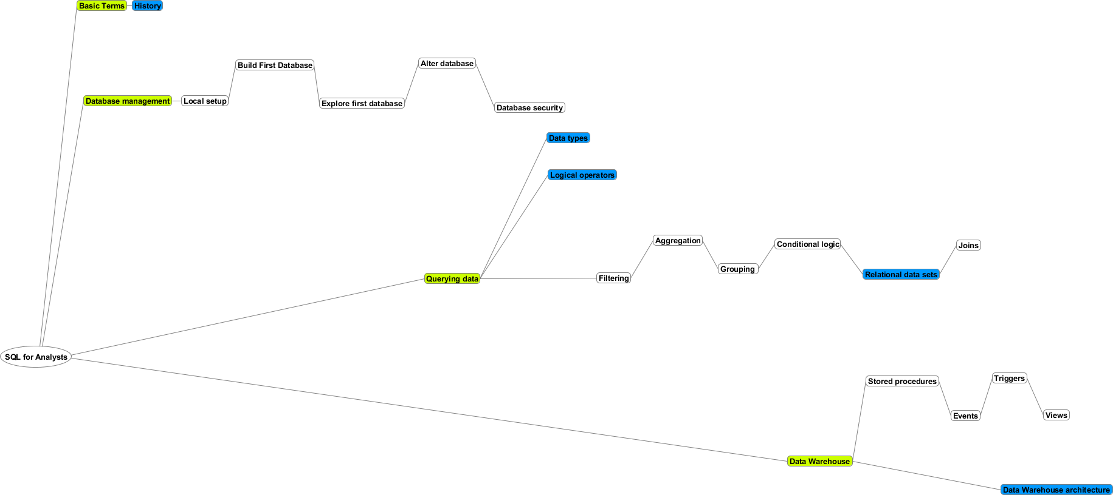
COURSE MINDMAP
CHAPTER 1
CHAPTER 2
Legend
Main Node
Presentation
CHAPTER 3
CHAPTER 4
CHAPTER 5
CHAPTER 6

Slide 13
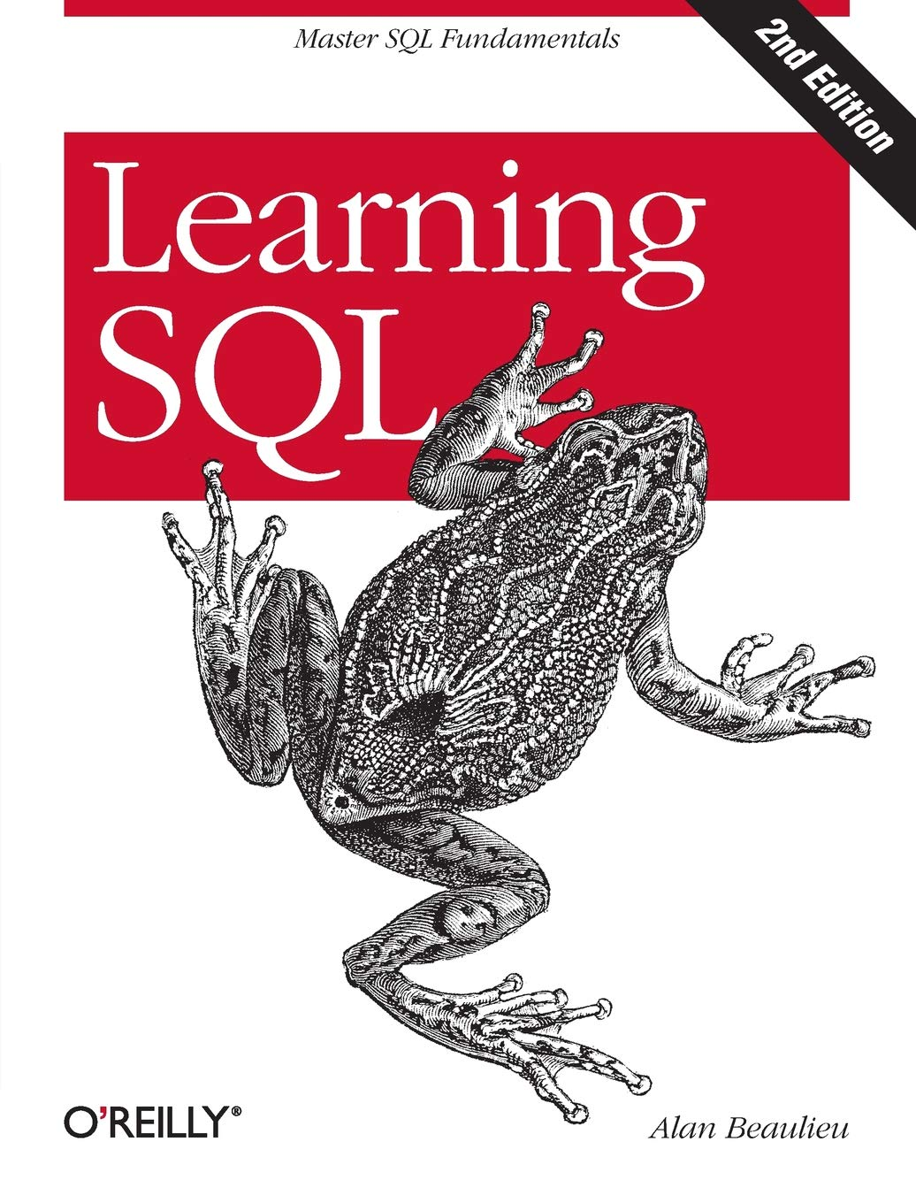
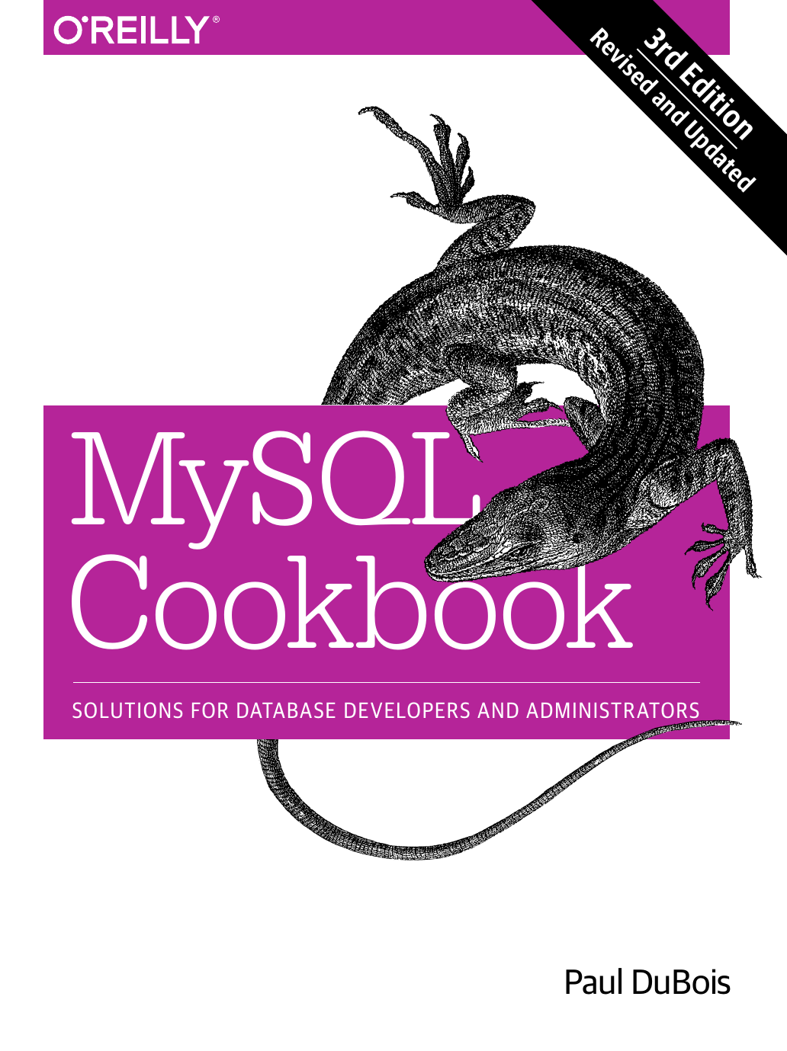


BOOKS & OTHER MATERIALS
https://www.w3schools.com/sql/sql_intro.asp
https://dev.mysql.com/doc/refman/8.0/en/
https://www.mysqltutorial.org/

Slide 14
COURSE KNOWLEDGE BASE
CEU Moodle
GIT
https://ceulearning.ceu.edu
https://github.com/salacika/DE1SQL

Slide 15

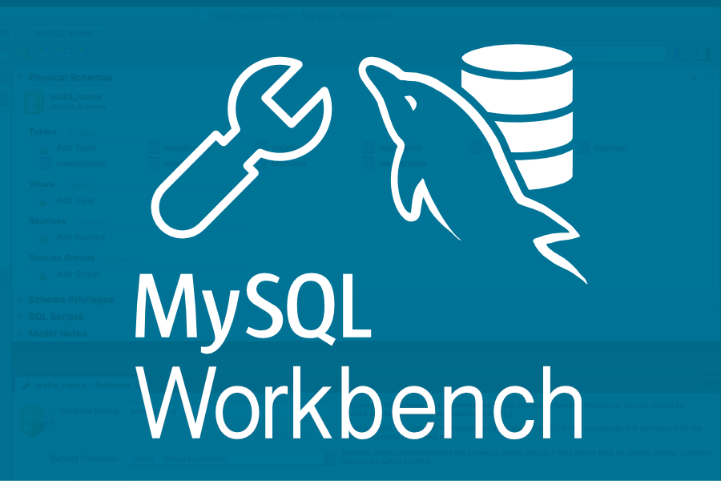
ENVIRONMENT TO SETUP
+

Slide 16
EVALUATION AND EXPECTATIONS
Questionnaire as Exam (40%)
Term Project (60%)
Intellectual contribution aka BE PRESENT
HELP each other
Do not DESPAIR, ask for help
DO the extra mile

Slide 17

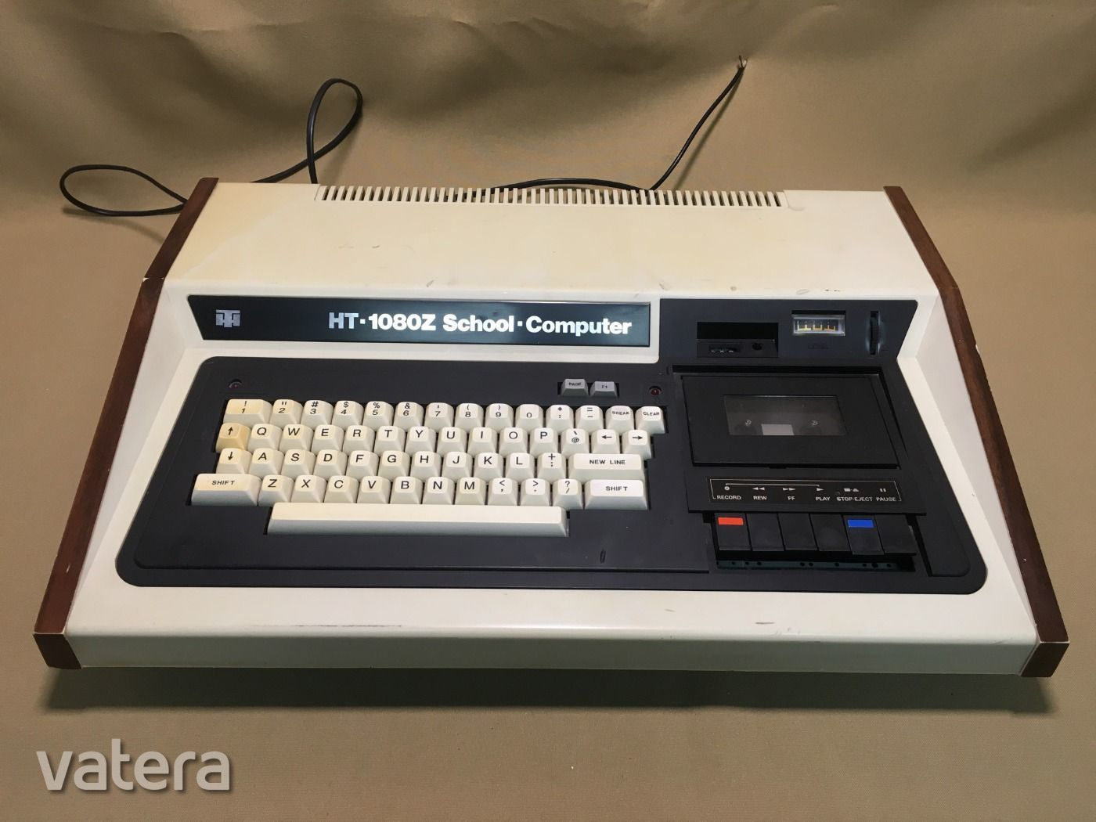


ABOUT ME
LASZLO SALLO (Head of Engineering for Hungarian Delivery Office of Vanguard Group)
LinkedIn: https://www.linkedin.com/in/laszlosallo
Mail: sallol@ceu.edu

Slide 18



STUDENT SUPPORT
Teaching assistant: Sandor Budai (BudaiS@ceu.edu )
Communication: email or slack (de1-2020 channel on ceu-bizanalytics)
Tutoring: on demand, afternoons on Zoom

Slide 19
PRESSING QUESTIONS OF CHAPTER 1
What is SQL?
What is a Relational Model?
What is a Relational Database?
What is RDBMS?
What is MySQL?
Difference between MySQL and other RDBMS?

Slide 20

THE HISTORY OF DIGITAL PERSISTENCY

Slide 21

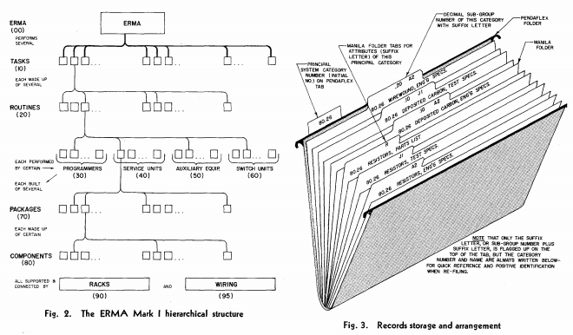
50’s FILE SYSTEM ROCKS!

Slide 22

60’s DATABASE FOR PEOPLE
Database Management Systems:
Simultaneous access to data
Security / User management
Administration
Unified access interface

Slide 23
TABULAR
TABLE
COLUMN or FIELD
HR_EVENTS
ID | DATE | NAME | EMAIL | OPERATION | TITLE | TITLE_REFID
1 | 2015.05.09 | John | john@company.com | join | Junior Analyst | 34
2 | 2017.05.10 | Kate | kate@company.com | promotion | Senior Analyst | 67
3 | 2017.05.10 | John | michael@company.com | departure | Senior Analyst | 67
4 | 2017.05.11 | Mary | mary@company. com | join | Lead Analyst | 23
ROW or RECORD

Slide 24
RELATIONAL
EVENT
PRIMARY KEY
ID | DATE | EMPLOYEE_ID | OPERATION | TITLE_ID
1 | 2017.05.09 | 1 | join | 3
2 | 2017.05.10 | 2 | promotion | 2
3 | 2017.05.10 | 1 | departure | 2
4 | 2017.05.11 | 4 | join | 1
EMPLOYEE
ID | NAME | EMAIL
1 | John | john@company.com
2 | Kate | kate@company.com
4 | Mary | mary@company.com
FOREIGN KEY
TITLE
ID | TITLE | TITLE_REFID
1 | Lead Analyst | 23
2 | Senior Analyst | 67
3 | Junior Analyst | 34

Slide 25
DATABASE NORMALIZATION
The process of organizing the columns and tables of a database to reduce data redundancy and improve data integrity.

Slide 26
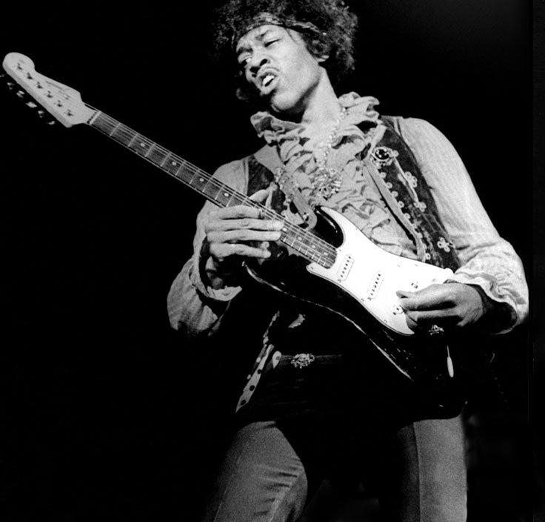
70’s HIT: THE RDBMS
Relational Database Management System
A digital database using the relational model of data for storing data

Slide 27

80’s DISCO: SQL RDBMS
Structured Query Language
is a language
designed to interact (“talk”) with a database.
“Find all customers”
“Add a new product”
“Delete orders”
Standardized but multiple dialects.
Once you learn on dialect,
you can easily switch to another

Slide 28
SQL EXAMPLE
EVENT
ID | DATE | EMPLOYEE_ID | OPERATION | TITLE_ID
1 | 2017.05.09 | 1 | join | 3
2 | 2017.05.10 | 2 | promotion | 2
3 | 2017.05.10 | 3 | departure | 2
4 | 2017.05.11 | 4 | join | 1
SELECT TITLE_ID FROM EVENT WHERE ID=3
TITLE_ID
2

Slide 29



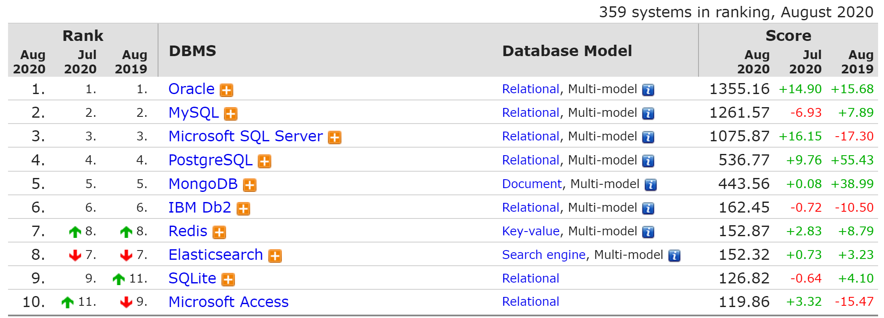

SQL MONOPOLY 1980-2010

Slide 30
MYSQL VS …
Available for free
Most widespread RDBMS
Does not strives to be 100% standard SQL compliant
Less strong in enterprise features, yet not lightweight
MORE:
https://www.keycdn.com/blog/popular-databases

